Slide 1

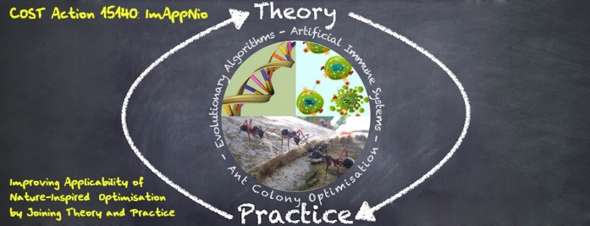

Reinforcement Learning
Alberto TONDA, INRA(E), Université Paris-Saclay France

Slide 2
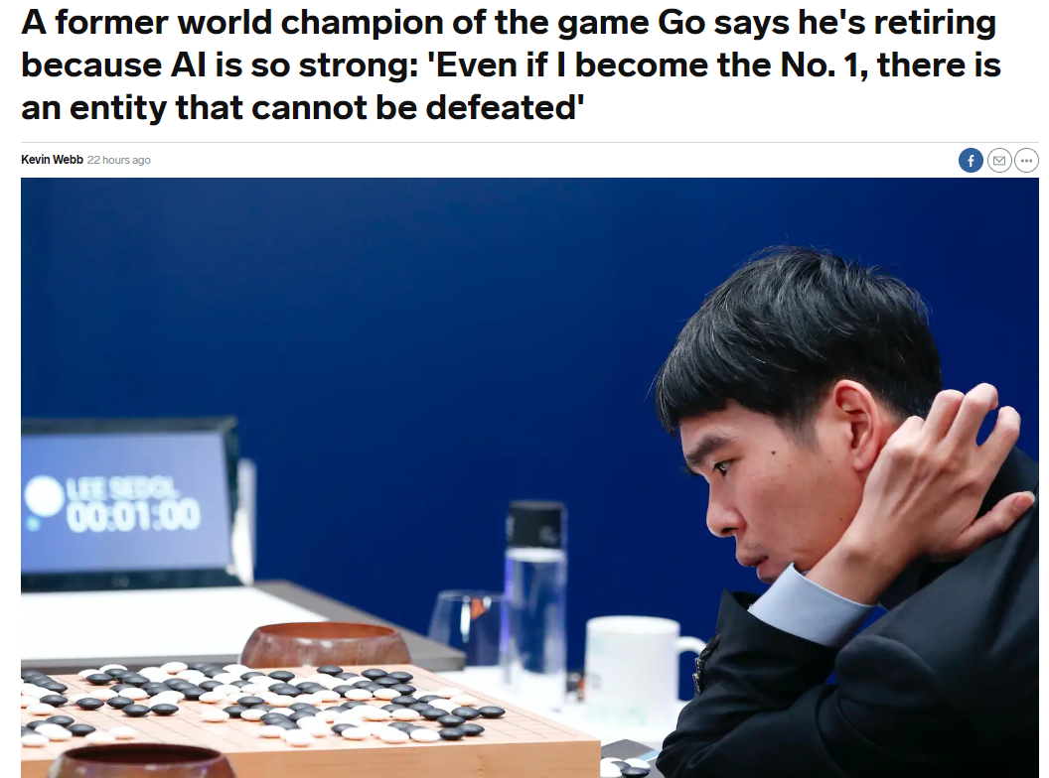
Reinforcement Learning
I do not know a lot about EA+RL
Why are we speaking about this?

Slide 3
Reinforcement Learning
Agent that needs to take decisions
Model current situation as «state»
In each «state», several «actions» are available
What is the best «action» in each state?
Basic idea of RL
Explore all states, take all actions
Reward actions that led to victory

Slide 4
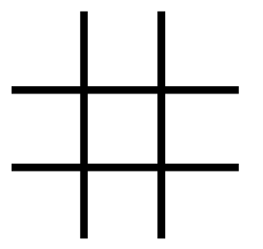
Reinforcement Learning
You played tic tac toe
You learned that first move NOT in corner or center leads to defeat

Slide 5
Reinforcement Learning
State: empty
Actions: ‘X’
Rewards: Green/Red

Slide 6
Reinforcement Learning
State: empty
Actions: ‘X’
Rewards: Green/Red

Slide 7
Reinforcement Learning
States in tic tac toe: 3⁹ = 19,683 (upper bound)
States in Chess: 10²⁰
States in Go: 10¹⁰⁰
Number of atoms in the universe: ~10⁸⁰
We cannot store the state/action table in memory...can we replace it with a function?

Slide 8

(Deep) Reinforcement Learning
Pioneered (for real applications) by Google
AlphaGo, AlphaZero
Replace state/action table with a deep network
How deep? Pretty deep (13+ layers)

Slide 9
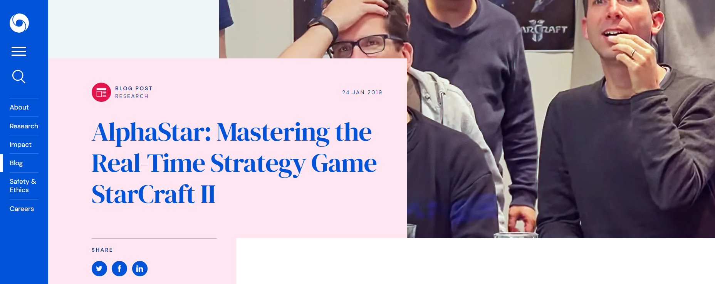
(Deep) Reinforcement Learning
Current developments!

Slide 10
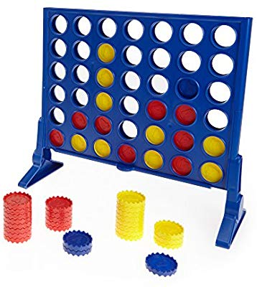
(Deep) Reinforcement Learning
Tutorial for «connect four»
https://azfour.com/
https://towardsdatascience.com/from-scratch-implementation-of-alphazero-for-connect4-f73d4554002a

Slide 11
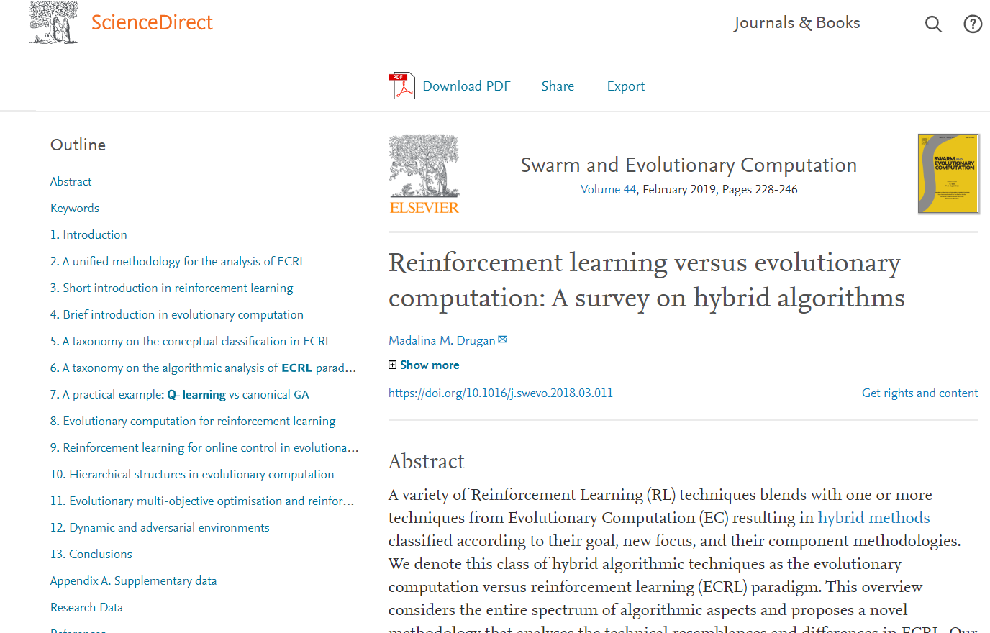
Evolutionary Reinforcement Learning?

